Slide 1
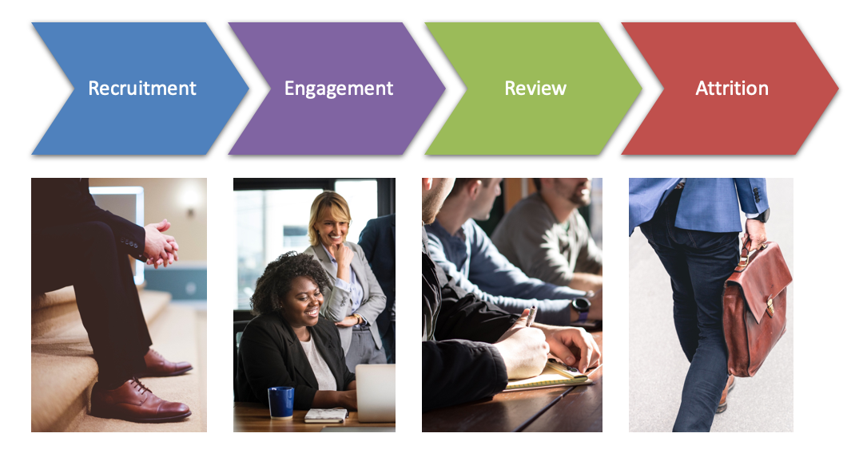
Data Science Use Cases in HR
In order to build a rewarding employee experience, you need to understand what matters most to your people

Slide 2
Data Science Use Cases in HR
Talent Acquisition and Resume Filtering/ Screening
Reducing Employee Turnover/ Churn Prediction
Advanced Operational Dashboards
Interactive ChatBOT for Candidates Engagements
Employees Career Dashboard/ Self Assessment Module
Sentiment Analysis of Customers/ Employees Reviews
SWOT Analysis Model
Workforce Analytics And Planning
Many Other Use Cases Depends on Data you have!!

Slide 3

Data Science Use Cases in HR
Which Data Science Use Case we can Deploy?
This mainly depends on
Data you have in your company
The Requirements
Which Employees are likely to left soon? (Prediction in advance, so that we made resources available to avoid issue?
Which Candidate should we select? Identify best possible resource as per our requirements?
As a Recruiter, how should I filter among 1000 resumes/ CVs quickly so that I save time and hire candidates ASAP.
My our employees/ Clients thinking about our products/ services? Review Analysis and Emails Analysis Quickly?
And much more exciting use cases.

Slide 4

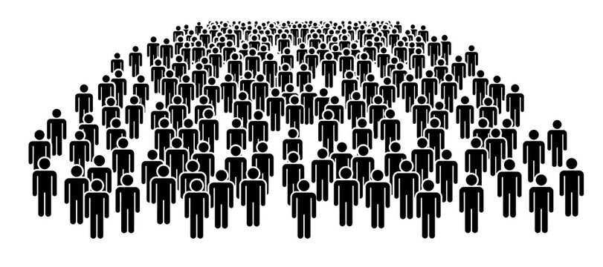


Talent Acquisition and Resume Filtering/ Screening
Hundreds/ Thousands of people apply for job
When You Post Job
Difficult to Check all CVs/ Resumes, Time Consuming, may Miss best Candidates
Lets Solve This Problem

Slide 5
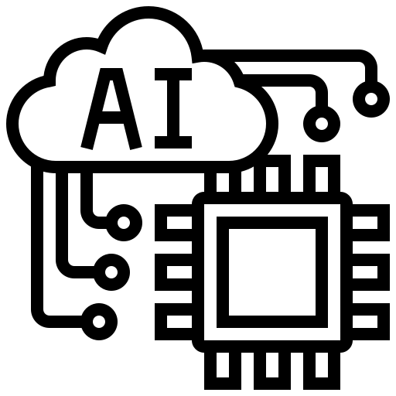
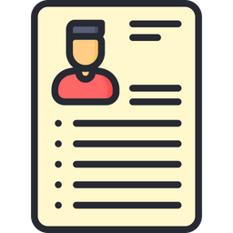


Talent Acquisition and Resume Filtering/ Screening
Multiple Resumes/ CVs
Company Defined Job Description
5 Years Exp, Manager etc
Artificial Intelligence System (NLP - TFIDF + Machine Learning)
Top 10 Most relevant CVS
Classify CVs Similar to JD
Not Applicable

Slide 6

Reducing Employee Turnover/ Churn Prediction
It is always in an organization’s best interest to retain an existing employee rather than hiring new employees for the same job role
Data Science can help identify which employees are more likely to stay a longer time within the organization by using Predictive Analysis
It helps you identify who will leave, why, and what you can do about it. In order to identify the needs of current and future employees, HR professionals can make use of Analytics to ensure effective recruitment and retainment

Slide 7
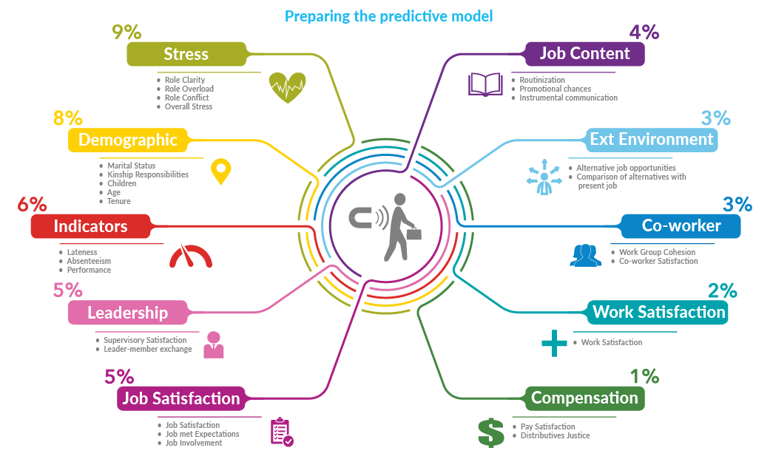
Reducing Employee Turnover/ Churn Prediction

Slide 8
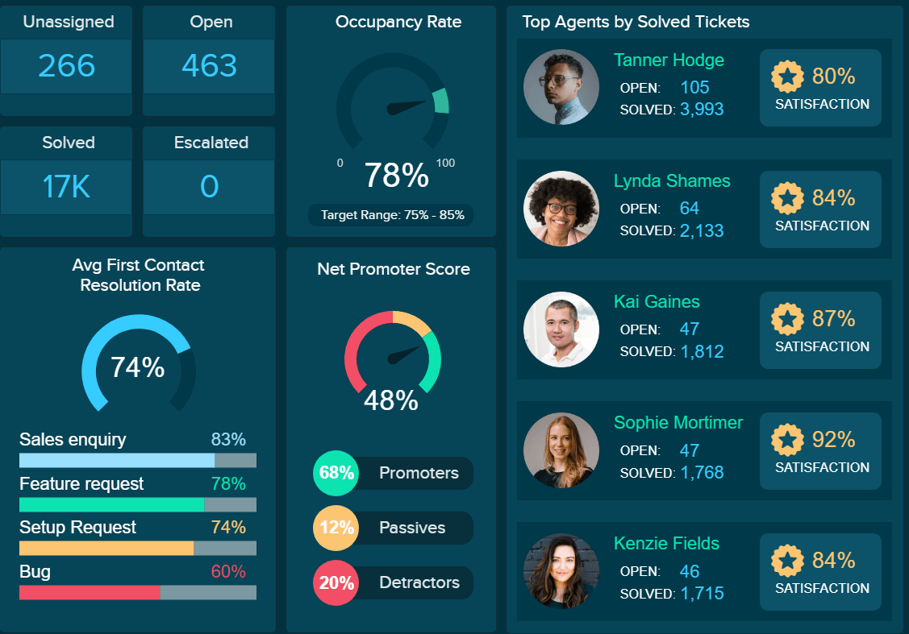
Advanced Operational Dashboards
Acquiring the right talent is just the first step to optimize business functions, the main challenge is the management of talent. We have learned that Data Science records employee performance, appraisals, compensation, behavior with regards to coworkers, upper management and HR, skillsets and experience, contribution made to the organization, how quickly they learn and apply a new skill. This information is analyzed, and insights are provided on how best to manage and retain them
The Solution is Detail Level Dashboard for HR

Slide 9
Interactive ChatBOT for Candidates Engagements
Asking Questions by Candidates is often part of Joining Process
Existing Employees may also ask multiple questions after joining like policies (Attendance, Medical, Insurance etc.), Salary raise, Performance etc.
HR if busy in other manual works will not be able to respond queries due to which we may MISS GOOD CANDIDATE or MAKE UNHAPPY an EXISTING EMPLOYEE
Solution is to deploy NLP Based AI ChatBOT

Slide 10
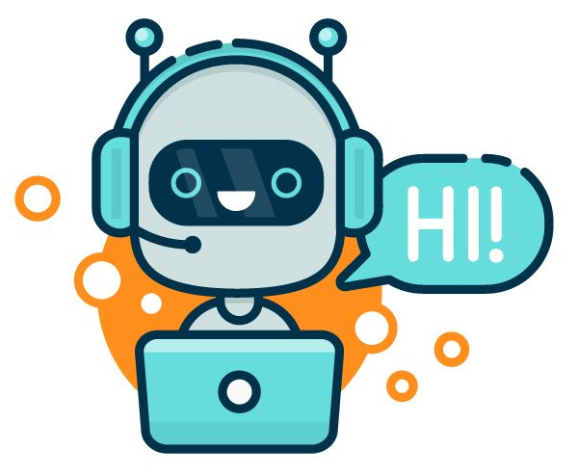


Interactive ChatBOT for Candidates Engagements
Policies
Employee or
Candidate
Intelligent ChatBOT
Intent Detection
Sentiment Analysis

Slide 11
Employees Dashboard/ Self Assessment Module
Promotion, Salary Raise and other types of favors play an important role in employees life in a company
Employees often feel grievances over others’ promotion, or less salary raise this year etc. etc.
This can lead best employees to quit job and switch
The solution is Advance Analytics Dashboard, which will show following:-
Thier Current Performance in term of hours per day, projects completed per month, issues resolved per week etc.
The Career of employee in comparison with best employees
The possible steps (suggestions such as complete course, make 100% attendance etc) to improve employee score

Slide 12
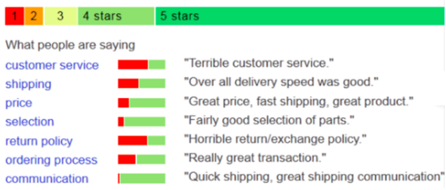
Analysis of Customers/ Employees Reviews
Survey about the processes/ products/ services on weekly/ monthly basis is normal in big companies
Evaluating those reviews is tedious task when you have hundreds of employees or thousands of Customers
You can leverage Machine Learning (NLP) to evaluate/ analyze reviews automatically and classify them as Positive, Neutral or Negative Reviews

Slide 13
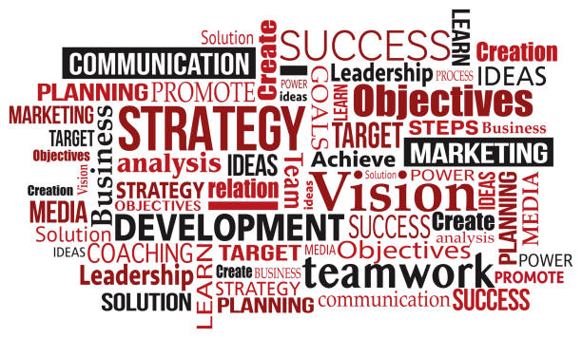
SWOT Analysis Model
Identifying Strength, Weaknesses, Opportunities and Threats is very important step for any company to survive
The HR Process needs continuous improvement
For that purpose there should be weekly or monthly reviews surveys/ questionnaires about current companies process and suggestions must be asked from employees in order to retain them (avoid churn)
The Problem is analyzing the response efficiently and quickly
We can develop an AI system which will use Natural Language Processing Tools to analyze automatically the key points

Slide 14
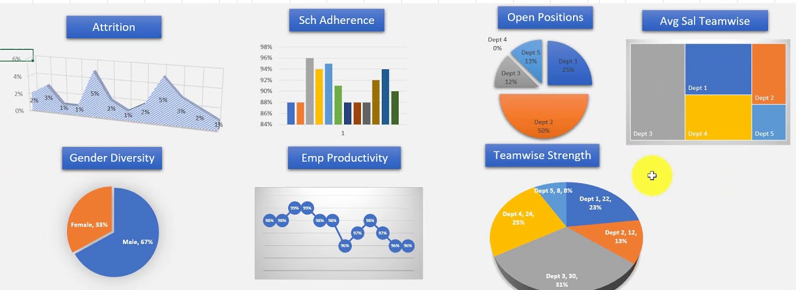
Workforce Analytics And Planning
This is another way of understanding the key needs of an organization. It deals with size, type, experience, knowledge and other such attributes that are important for enhancing the overall efficiency of an organization. This will help to maximize the throughput and ensure future business success.

Slide 15
Other Possible Use Cases
Project Hours Prediction
Using Past Data Train a Machine Learning that will predict the number of hours required to complete a project.
Project Team Members Prediction
Using Past Data Train a Machine Learning that will predict the number of people in a team required to complete a project.
Cost Management
In our experience, Data Science has helped tremendously in optimizing and controlling costs incurred to an organization. Analytics helps manage costs incurred during recruitment, onboarding, training and managing remuneration.
COMPENSATION & BENEFITS
In our experience, allowing employees to partake in the decisions regarding benefits such as Work from Home, insurance policies, holidays and sick leaves, and training services optimizes employee engagement. HR functions such as employee absenteeism, engagement and attrition can be monitored using HR Analytics function. Data science will help you identify key drivers that will retain and reward the right talent while boosting your organization’s bottom line.

Slide 16
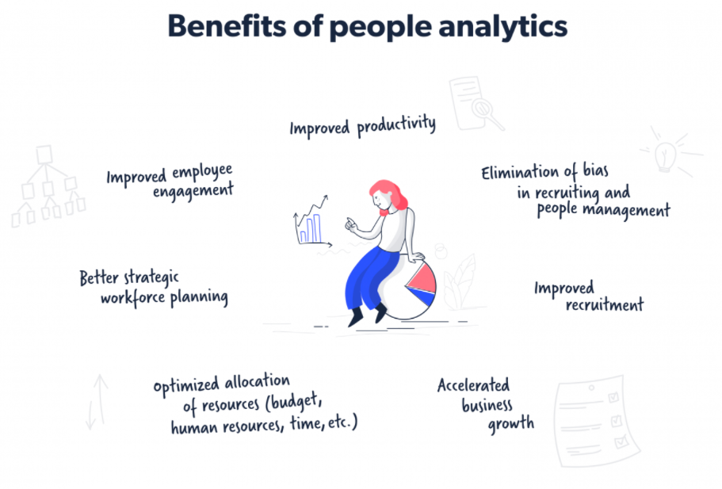
Other Possible Use Cases
Overall Analysis on HR related Data is helpful

Slide 17
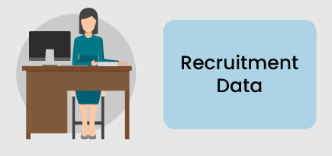
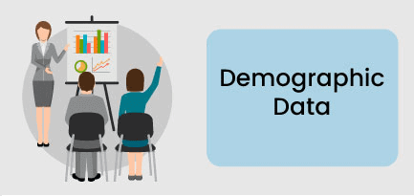


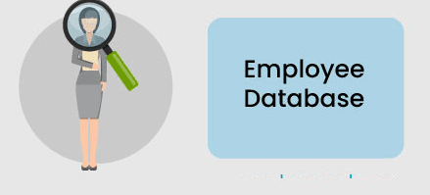
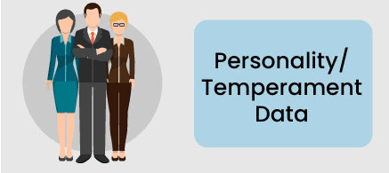


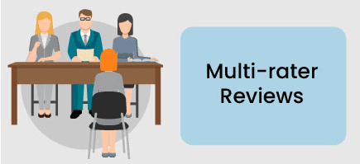
Data Sources

Slide 18
Technical Steps
Data Collection from Multiple Sources
Data Pre-processing
Machine Learning Modeling
Models Deployment
End Users Systems
Dashboards for HR
Dashboards for Employees
AI Services/ Notifications etc.

Slide 19

Data Science Use Cases in HR

